Slide 1
Investigation of Flexible Perovskite Solar Cells for Space Applications
Sierra Monreal
Arizona State University

Slide 2
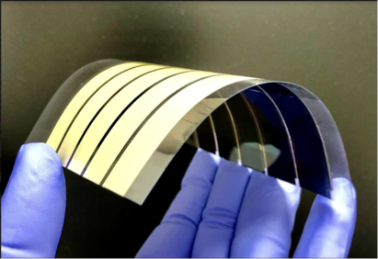
Flexible Perovskite Solar Cells (PSCs) can be used for a variety of applications
Offers a solution to current problems faced in a variety of areas
space, wearable sensors, buildings, vehicles, etc.
Adaptable, low cost, lightweight, powerful, and transportable
Research Goals: Fabricate sustainable flexible perovskite solar cells, characterize their electronic properties, and conduct stress tests that simulate environments in space
This research also aims to translate the pre-existing knowledge of PSC fabrication on rigid substrates to flexible substrates
Figure 1: Depiction of PSCs fabricated on flexible substrates¹

Slide 3
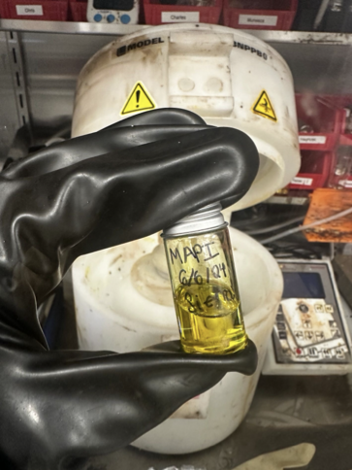
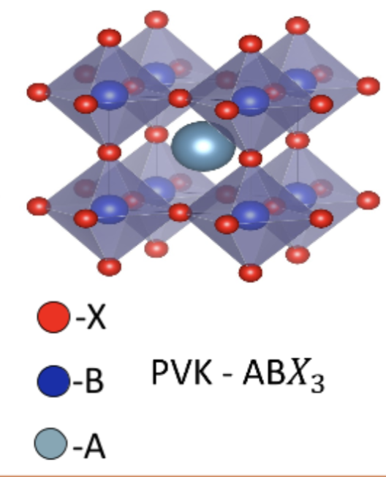
Methylammonium Lead Iodide (MAPbI3) Ink
Relevance:
MAPI recipe:
Large absorption coefficient due to its crystal structure
Previous research proves MAPI to be effective on rigid substrates
Powder Precursors
•Methylammonium Iodide (MAI)
•Lead Iodide (PbI2)
Solvents
•DMF
•DMSO
Vortex spin vial until clear solution is formed
Figure 2 (left): Crystalline structure of Perovskites²
Figure 3 (above): MAPI Ink

Slide 4
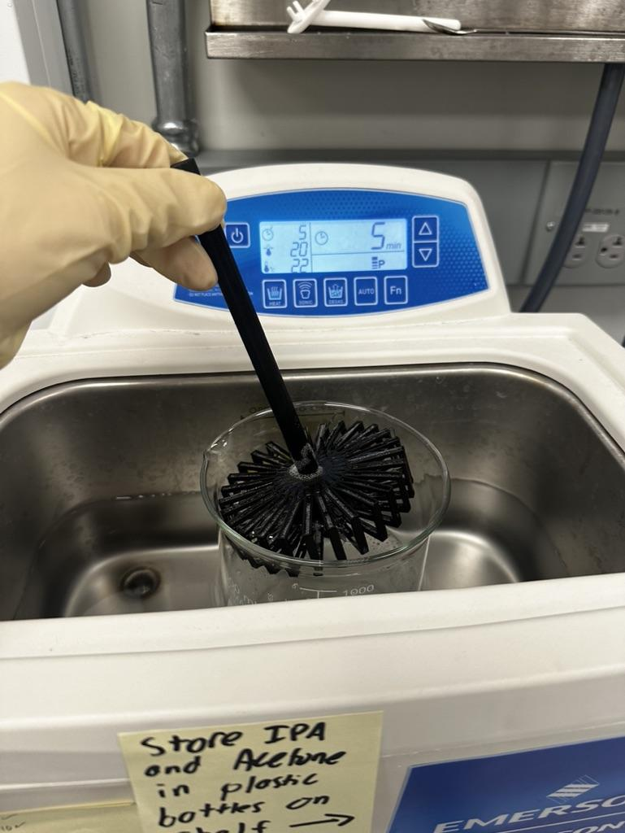
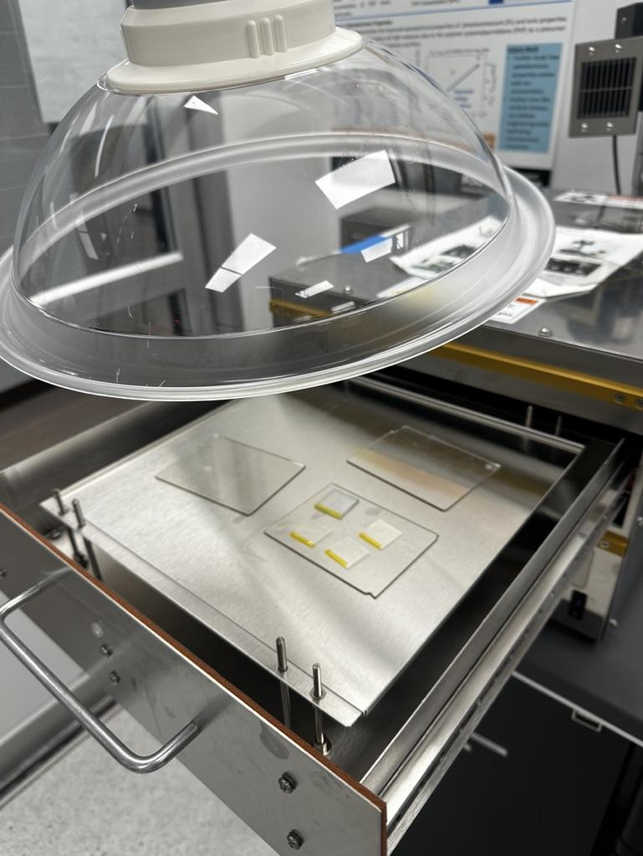
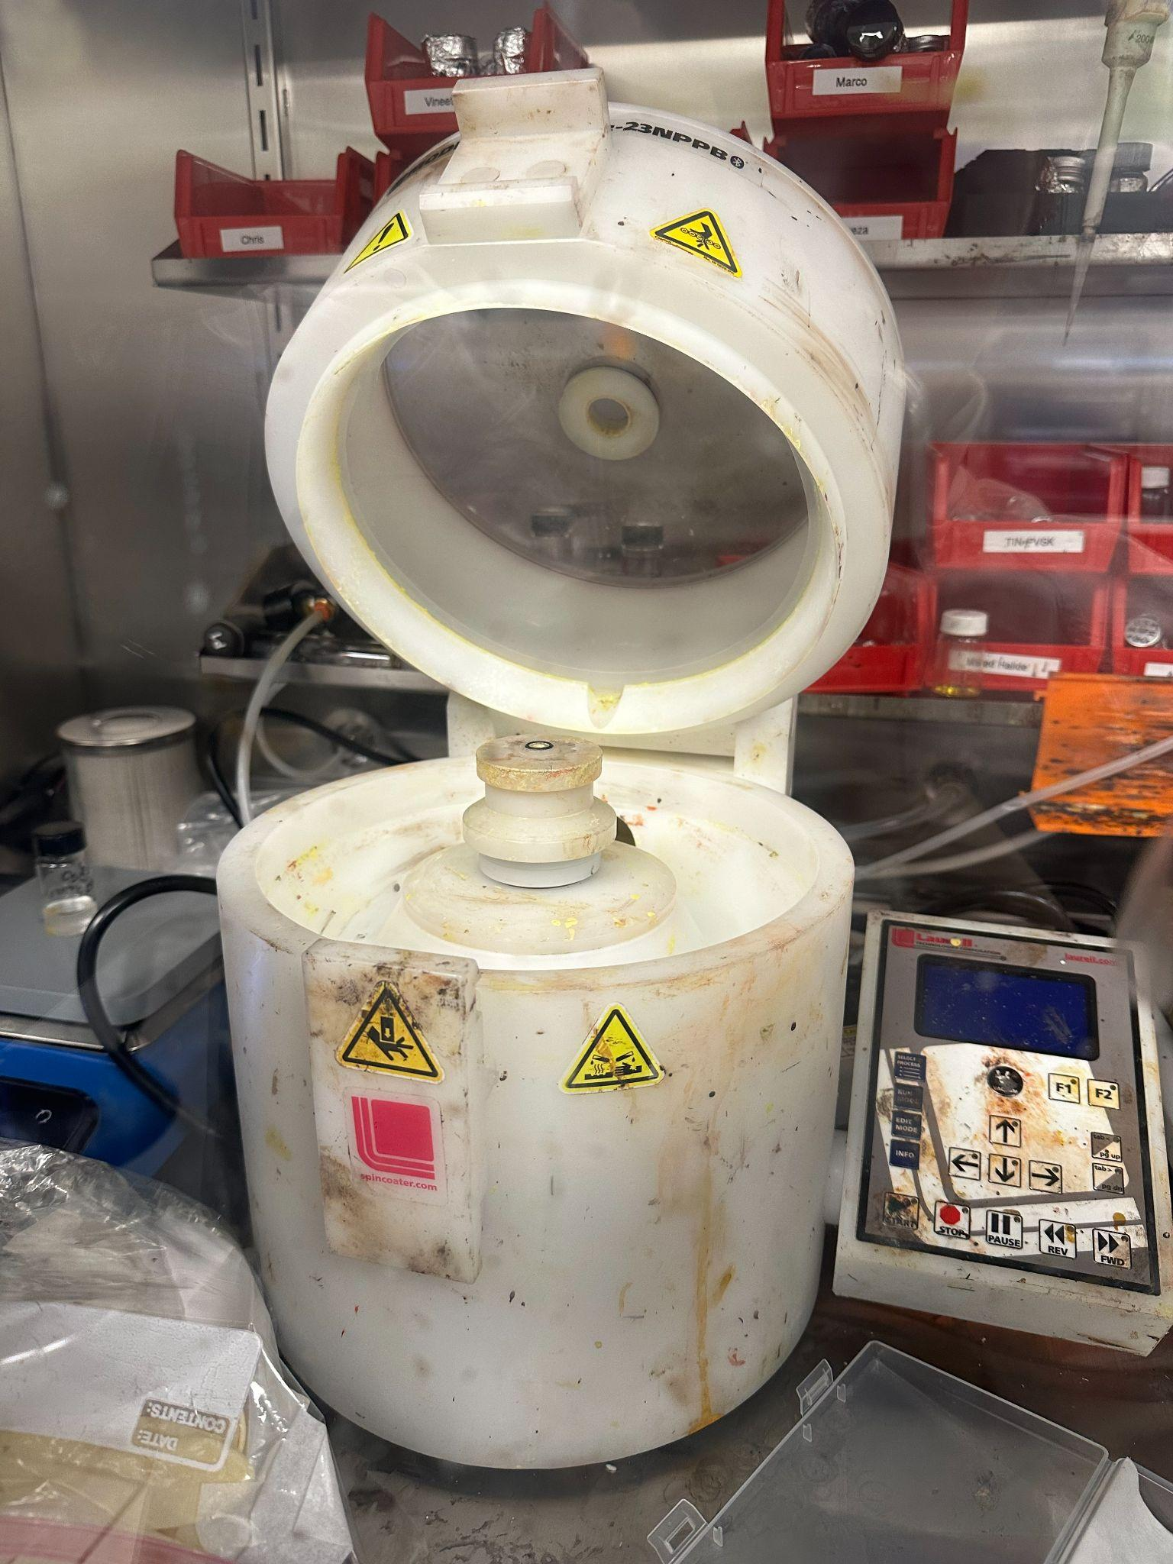
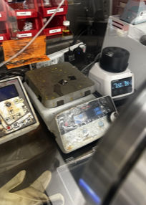
Fabrication of MAPI on
Polyethylene Terephthalate (PET)
Sonication | UVO Cleaner | Spin Coating | Annealing
Extran solution (Industrial grade soap) IPA | Improves adhesion of substrate | Deposit perovskite and anti-solvent using spin coater. | Crystallize solution into thin film through exposure to heat
Figure 4: Sonication process with substrate holder
Figure 5: Ventilation next to UVO cleaner
Figure 6: Spin coater used to coat flexible substrates with MAPI
Figure 7: Samples annealing following the spin process

Slide 5
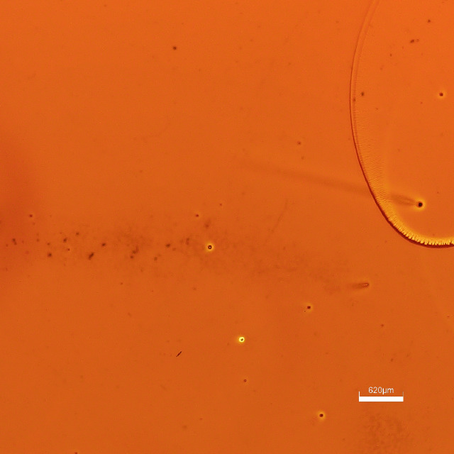
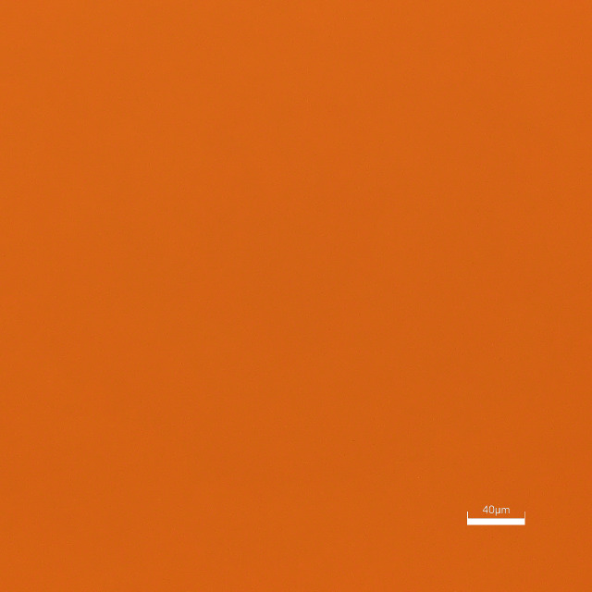
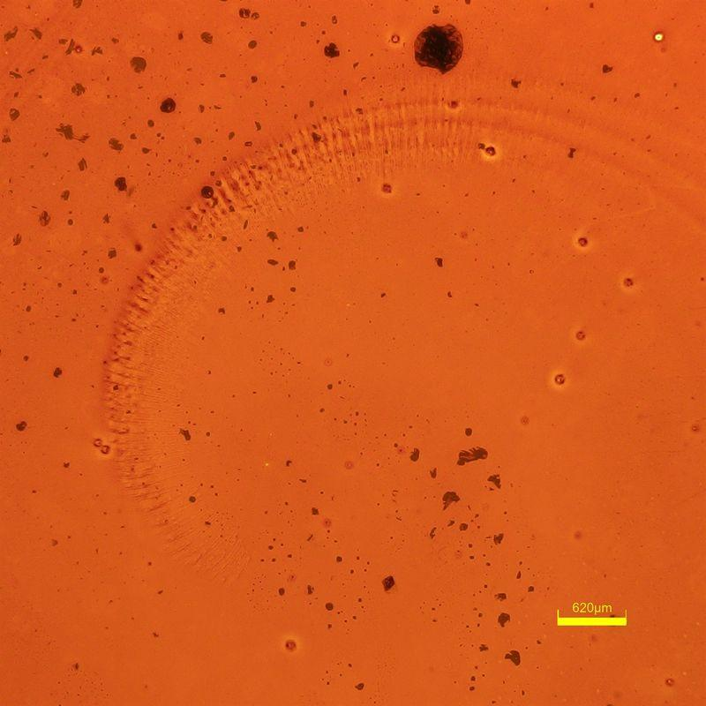
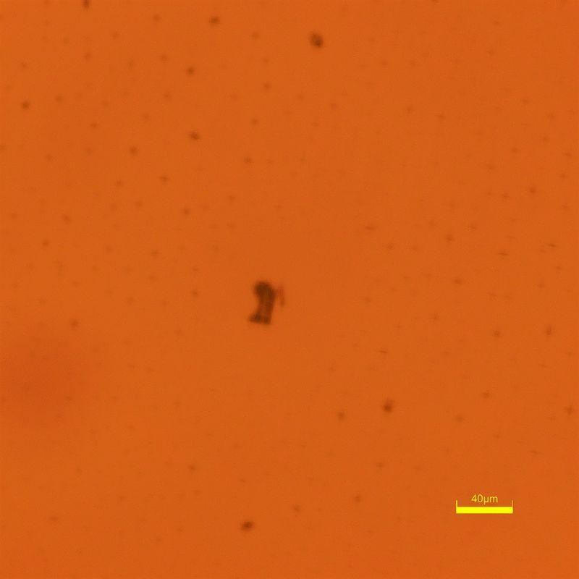
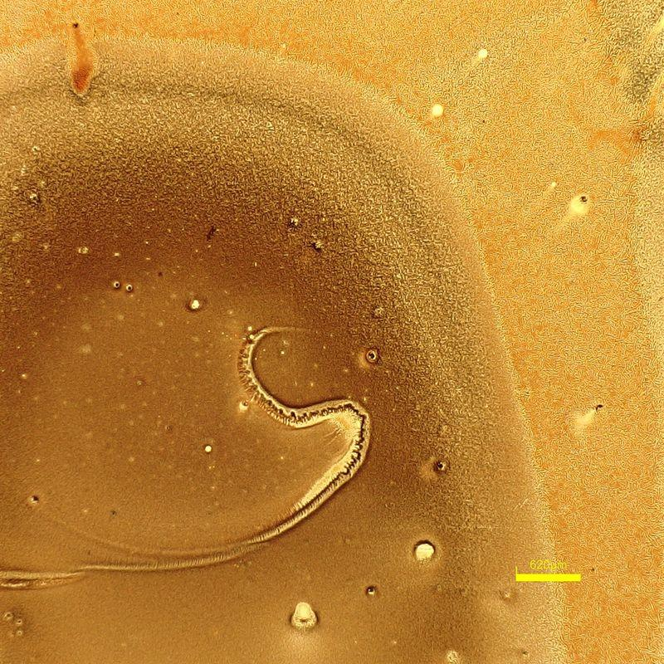
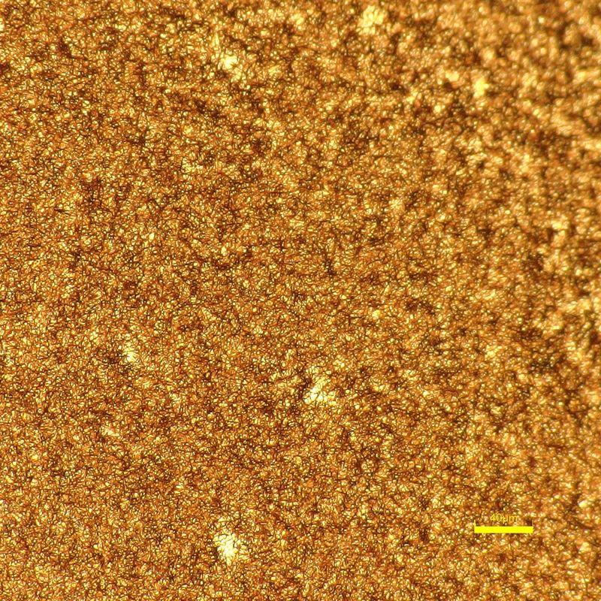
Determining the quality of film after spin coating
Optical Microscopy
Determines effectiveness of spin coat through confirming visual uniformity
Desirable Samples | Poor Quality Samples
Minimal/no defects in the film | Visible deformities, obvious irregularities
Figure 11&12 (left): sample h2 pictured at 43x and 620x
Figure 13&14 (left): sample h4 pictured at 43x and 620x
Figure 9: sample b1 pictured at 43x
Figure 10: sample b1 pictured at 620x

Slide 6
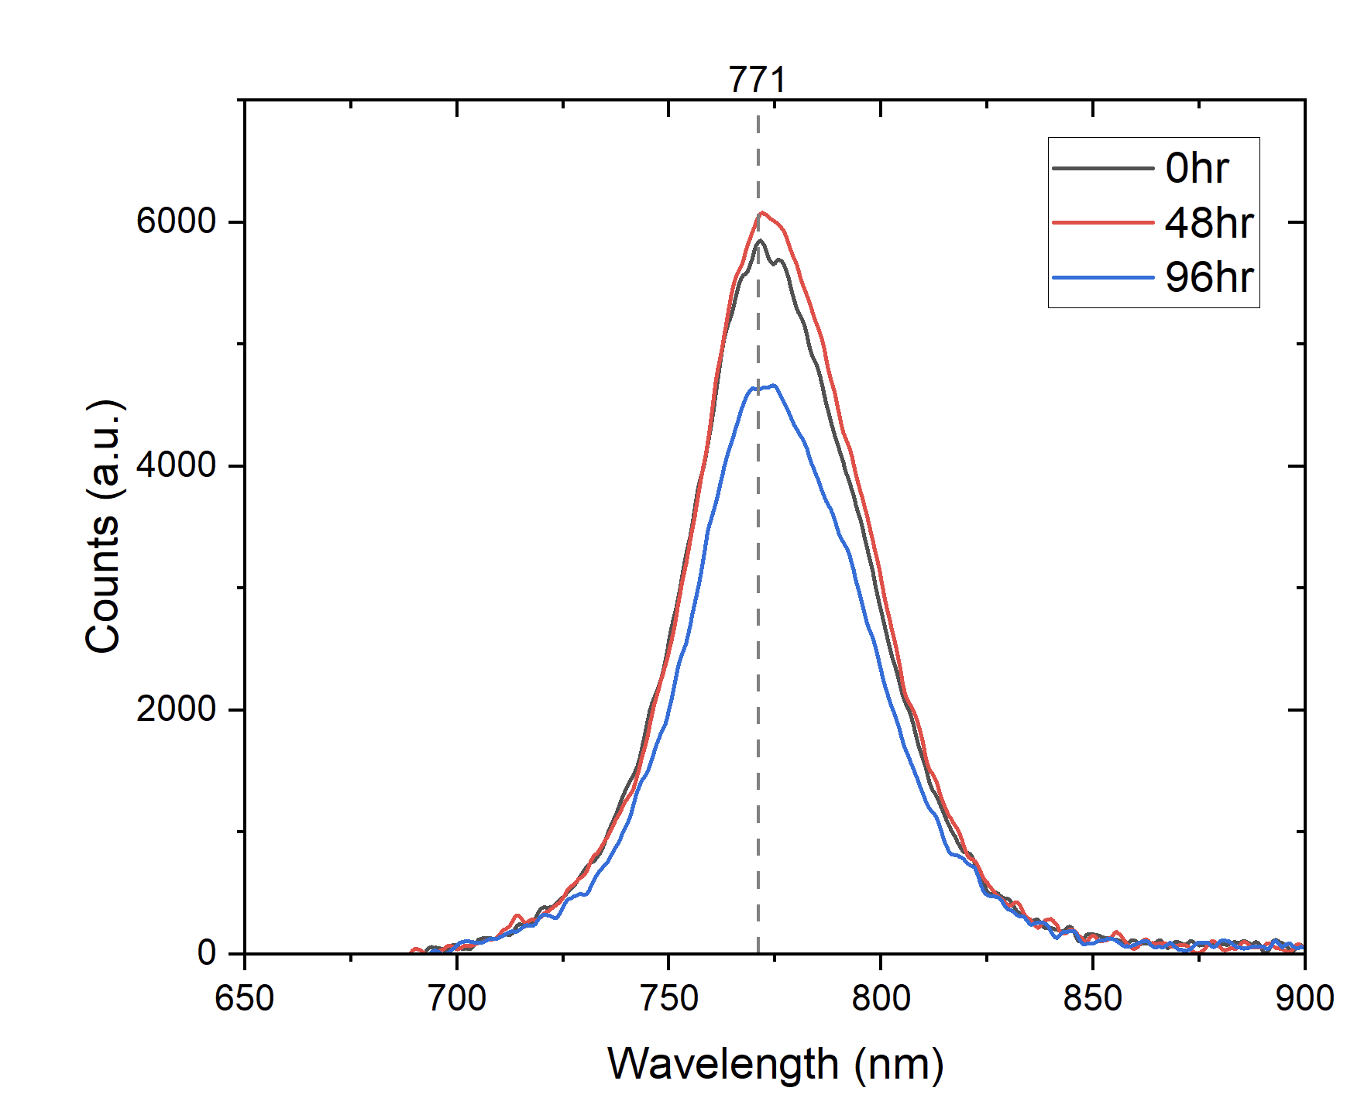
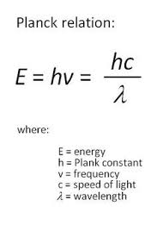
Determining the quality of film after spin coating
Photoluminescence Spectroscopy (PL)
Measures wavelengths of light by projecting photons using a laser onto the sample
By knowing the wavelength, we can calculate the bandgap (~1.6 eV)
hc= 1240 eV
Figure 15 (above): Relationship between wavelength and photoemission of solar cell over 96 hour testing period (tension, measured while bent)

Slide 7
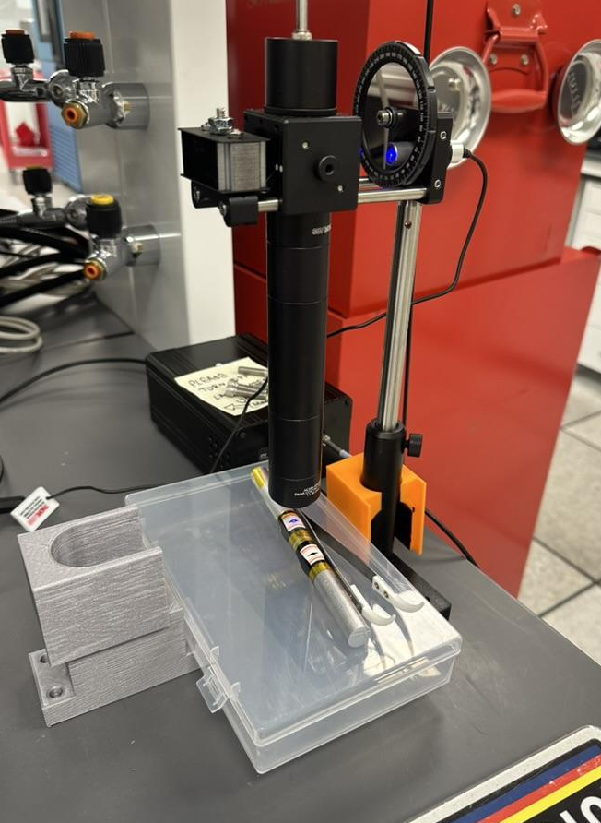
Characterizing Metal Halide Perovskite (MHPs) Samples
Process:
Divide samples into conditions they will be subjected to
Bending only
Bending + heat
Bending + UVB exposure
Measure PL of solar cells while bent at several time increments (0 hr, 48 hr, 96 hr)
Hypothesis: Compressive stress may promote self-healing properties
Figure 16 (above): Setup for measuring wavelength and photoemission

Slide 8
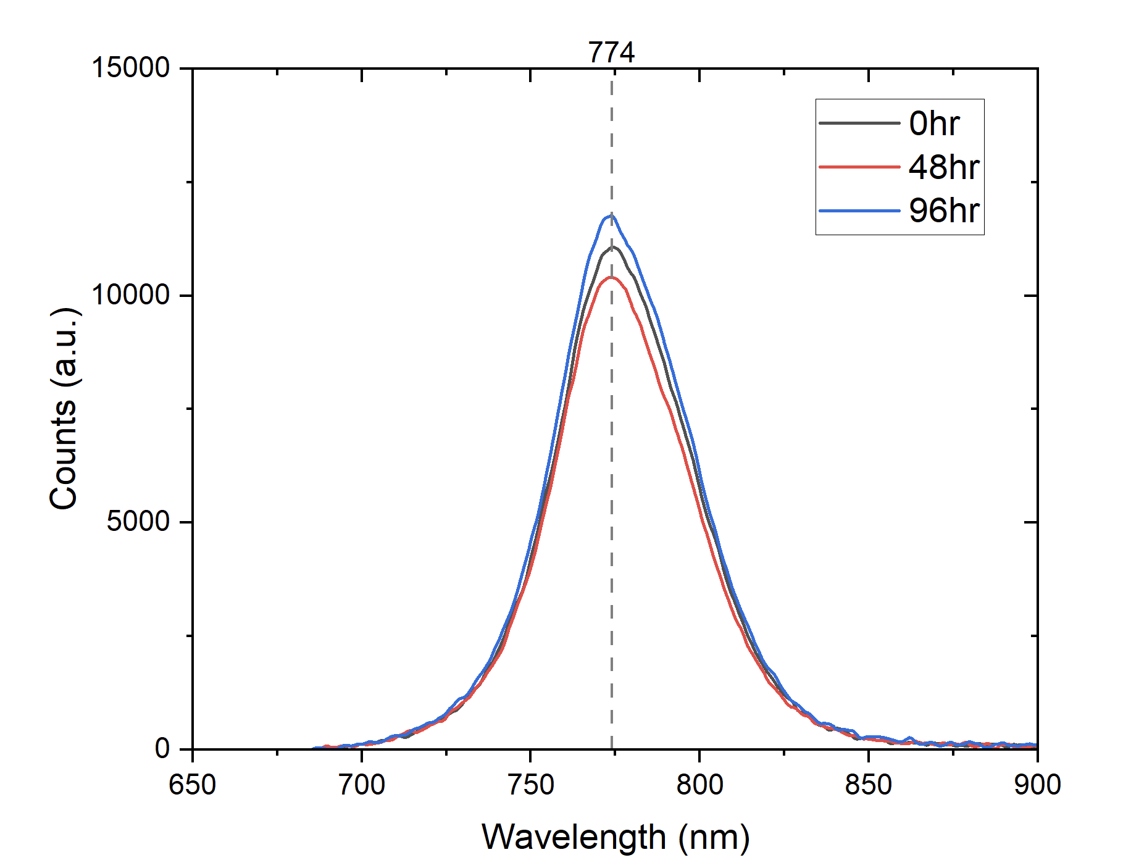
Result Interpretation- Bending Only
Figure 17 (above): Bent (tension) PSC over 96 hour period
Figure 18 (above): Bent (compression) PSC over 96 hour period

Slide 9
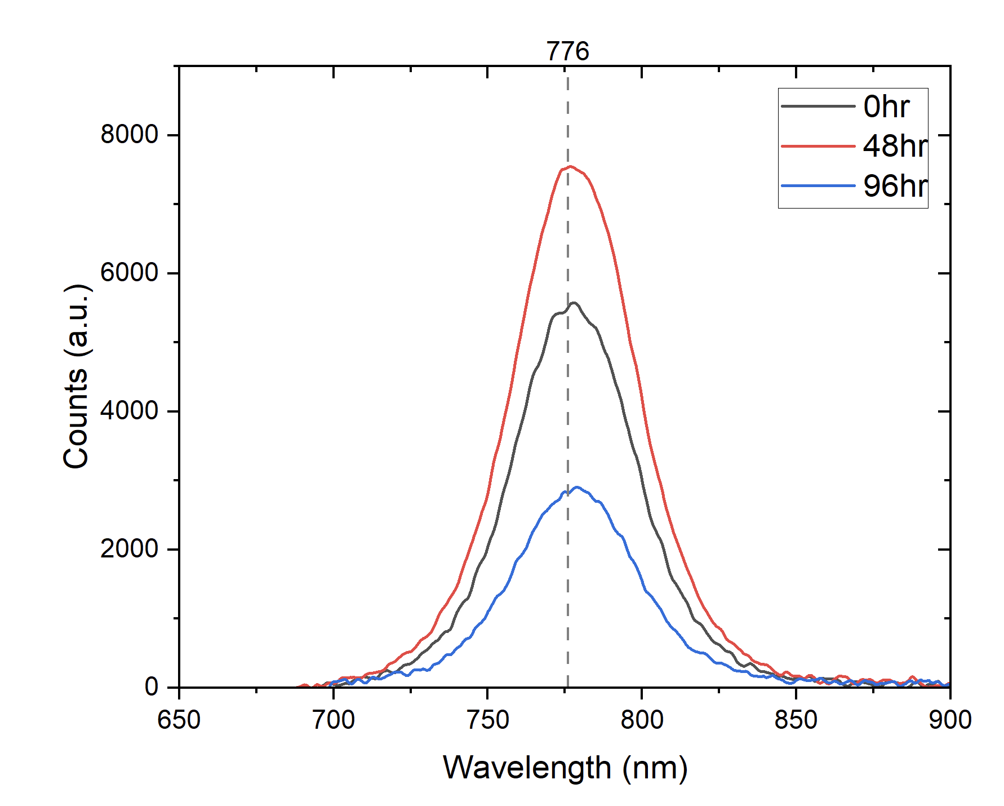
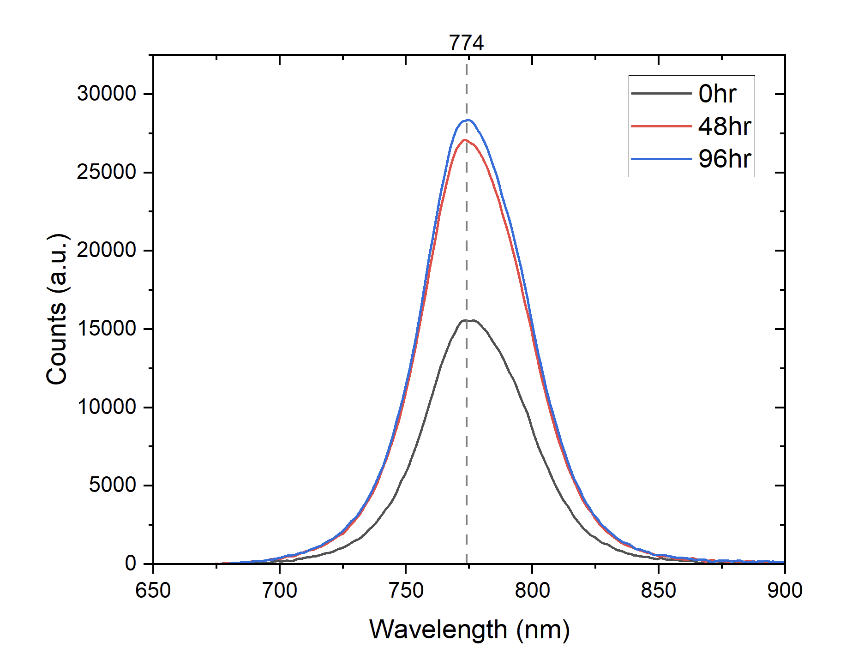
Result Interpretation- Bending + Heat
Figure 19 (above): Bent + heat (tension) PSC over 96 hour period
Figure 20 (above): Bent + heat (compression) PSC over 96 hour period

Slide 10
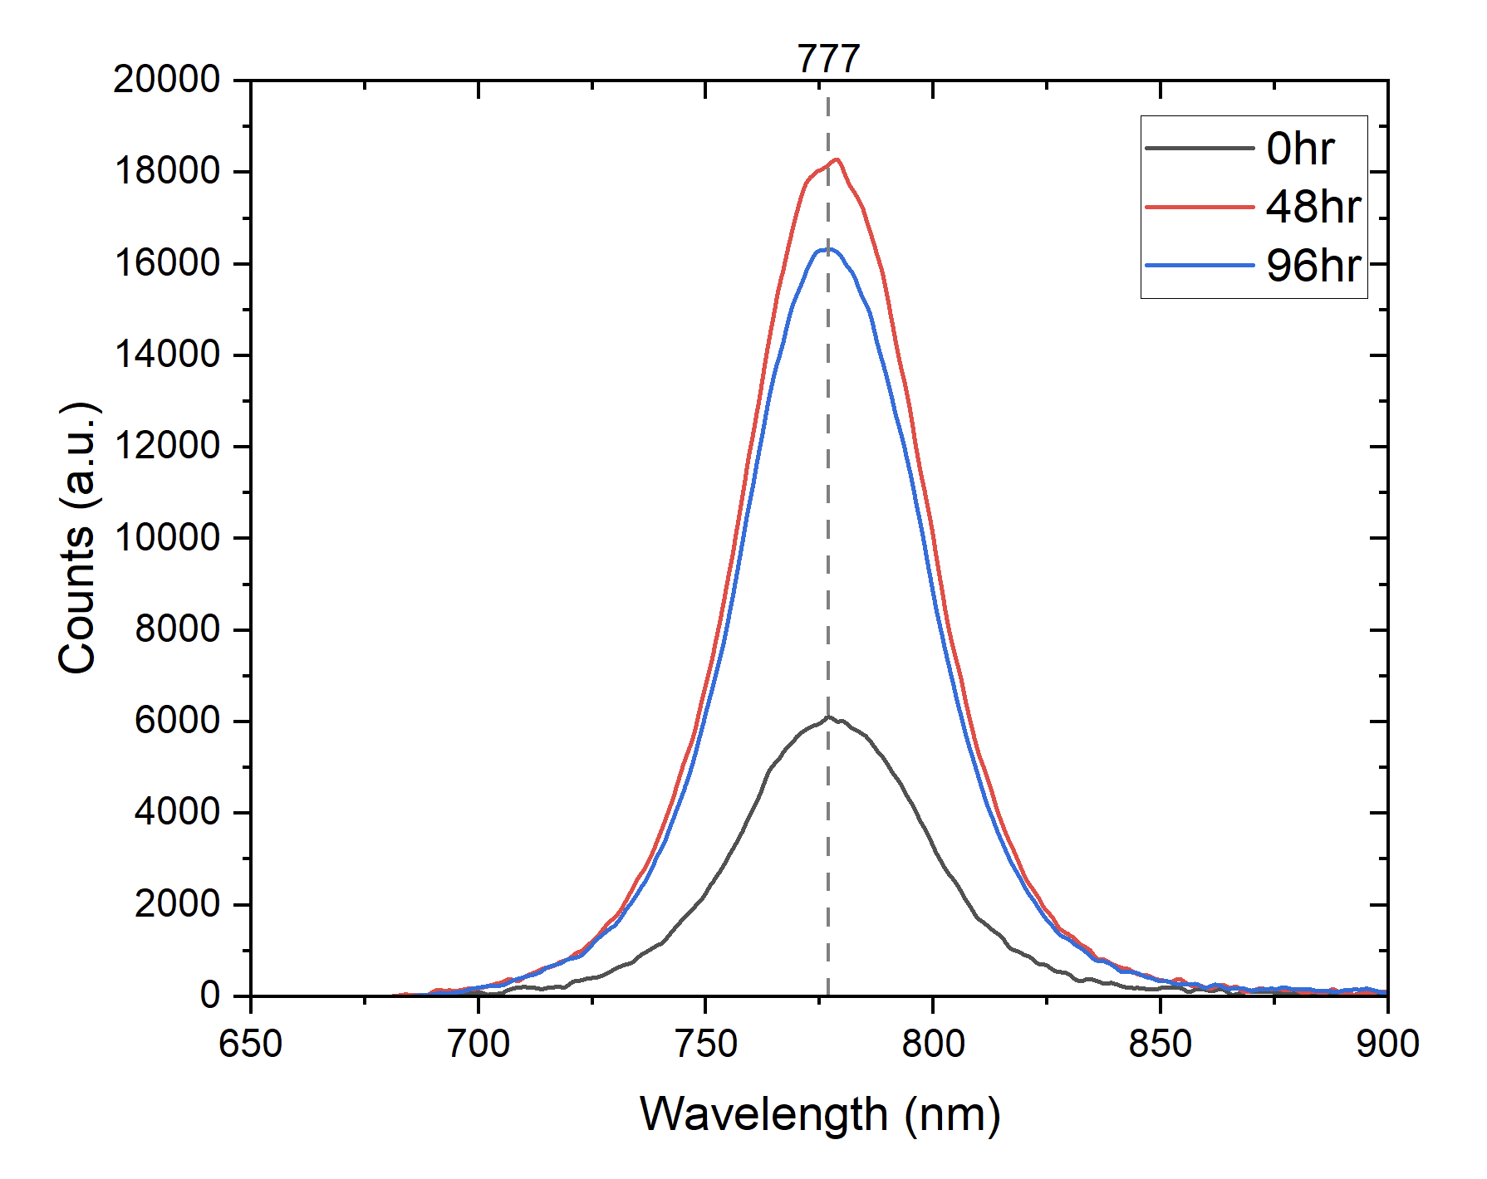
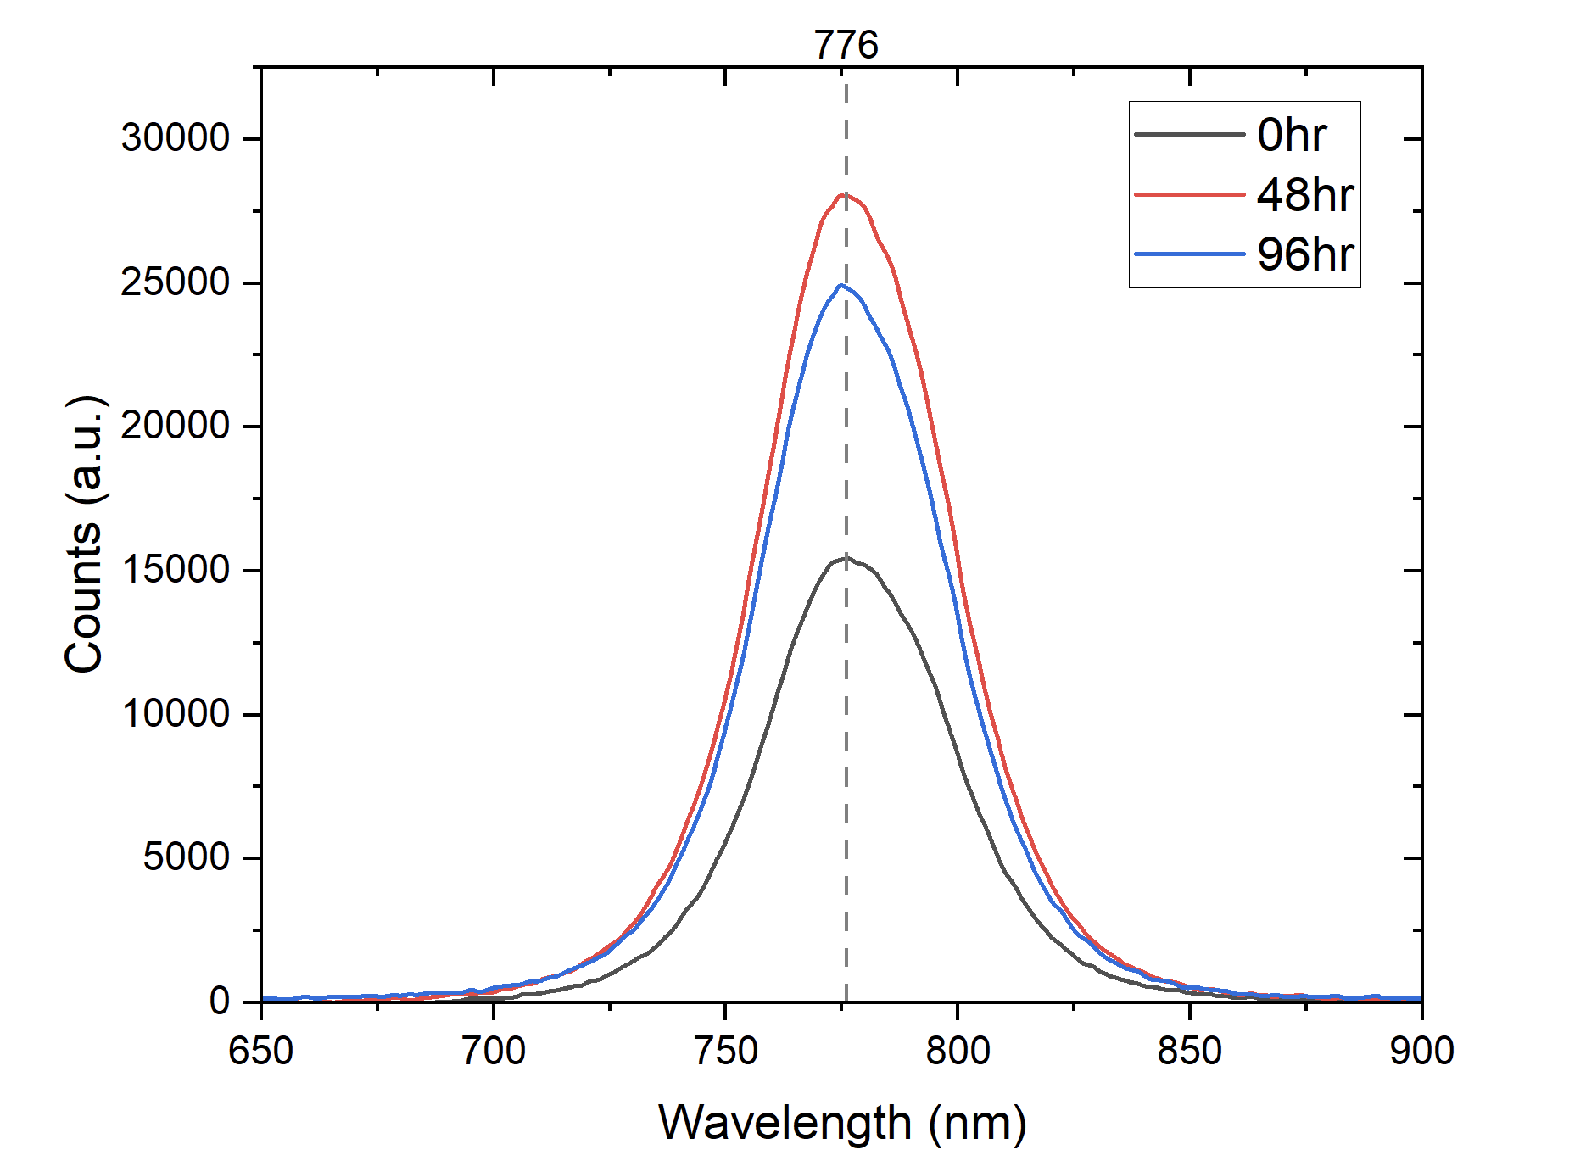
Result Interpretation- Bending + UVB
Figure 19 (above): Bent + UV (tension) PSC over 96 hour period
Figure 19 (above): Bent + UV (compression) PSC over 96 hour period

Slide 11
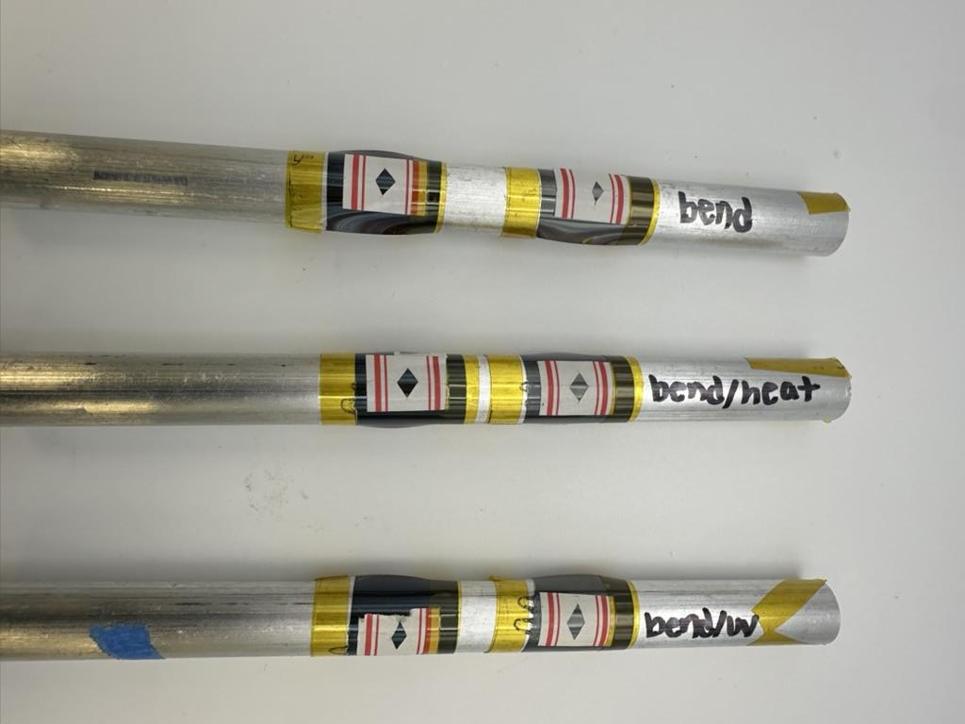
Future Plans
Complete more PL measurements to validate that compression is a more protective stressor than tension
Try dynamic bending cycles to see how it would compare to static bending
Construct devices incorporating flexible PSCs to evaluate their performance when encapsulated and protected

Slide 12
Works Cited
Figure 1:
Peleg, Roni. Researchers Fabricate Flexible Roll-to-Roll Perovskite Solar Cells with 16.7% Efficiency, 16 Sept. 2022, https://perovskite-info.com/researchers-
fabricate-flexible-roll-roll-perovskite-solar-cells-167-efficiency.
Figure 2:
Penukula, Saivineeth. Measurement of Ionic Nature of Halide Perovskites, 2024.

Slide 13




Thank You!
Acknowledgements
Dr. Nicholas Rolston
Saivineeth Penukula
Rolston Labs
Desiree Crawl
ASU/NASA Space Grant Program
Email:
snmonrea@asu.edu

